Slide 1
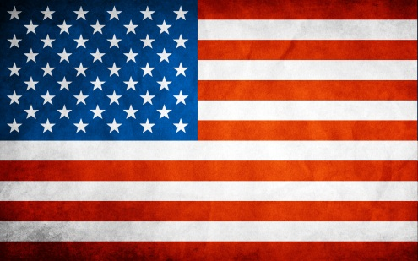
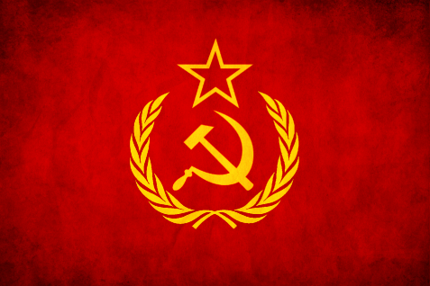
Different Goals
United States | Soviet Union
Fought to bring democracy Brought economic opportunity Economically strong & politically open world | Wanted to rebuild in ways that would protect its own interests Satellite nations Spread of communism Supported Communist revolutionists

