Slide 1
Sunnyside District Choral Festival
November 2, 2017

Slide 2
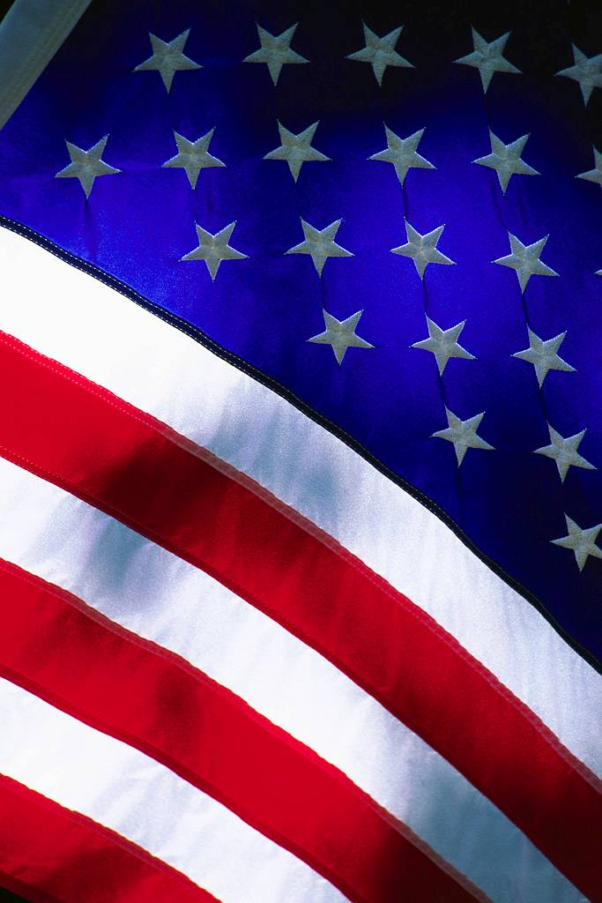

The Star-Spangled Banner
Our National Anthem
by Francis Scott Key
vocal
instrumental

Slide 3
Oh! say, can you see, by the dawn’s early light,
What so proudly we hailed at the twilight’s last gleaming?
Whose broad stripes and bright stars, through the perilous fight,
O’er the ramparts we watched were so gallantly streaming?
And the rockets’, red glare, the bombs bursting in air,
Gave proof through the night that our flag was still there.
Oh! say, does that star-spangled banner yet wave
O’er the land of the free and the home of the brave?

Slide 4

Music Alone
Shall Live
Himmel und Erde
German Round
vocal
pronunciation

Slide 5
Himmel und Erde müssen ver gehn;
Aber die musica, aber die musica,
Aber die musica bleibet bestehn.
All things will perish beneath the sky,
Music alone shall live, music alone shall live,
Music alone shall live, never to die!

Slide 6

Sakura
vocal
pronunciation
Cherry Blossom Time
Japanese Folk Song

Slide 7
Sakura Sakura ya yo i no so ra wa
Mi wa ta su ka gi ri ka su mi ka ku mo ka
Ni o i zo i zu ru i za ya i za ya
Mi ni yu ka n
Cherry tree, cherry tree! Cherry blossoms ev’rywhere.
Far as any eye can see. Mist and beauty fill the air,
Lovely blossoms scent the breeze. Come with me, Come with me,
Let us go and see.

Slide 8


Sing For Your Supper
Louisiana Creole Folk Song & Jamaican Calypso

Slide 9
Choir will be divided into 3 groups and will sing the song in the following order.
Sweet Potatoes
Sweet Potatoes w/ Roo Countermelody
Sweet Potatoes, Roo Countermelody, and Mango Walk (2x)
Sweet Potatoes Louisiana Creole Folk Song
Soon as we all cook sweet potatoes, sweet potatoes, sweet potatoes.
Soon as we all cook sweet potatoes, eat ‘em while they’re hot.
Roo Roo Countermeldoy Louisiana Creole Folk Song
Roo ---, roo, roo, roo, Hoo, hoo, Sing ho ------ kedinkum!
Roo---, roo, roo, roo, Hoo, hoo Hoo, hoo!
Mango Walk Jamaican Calypso
My mother deeda tell me that you go mango walk,
You go mango walk, you go mango walk.
My mother deeda tell me that you go mango walk,
And eat all the number ‘leven.

Slide 10
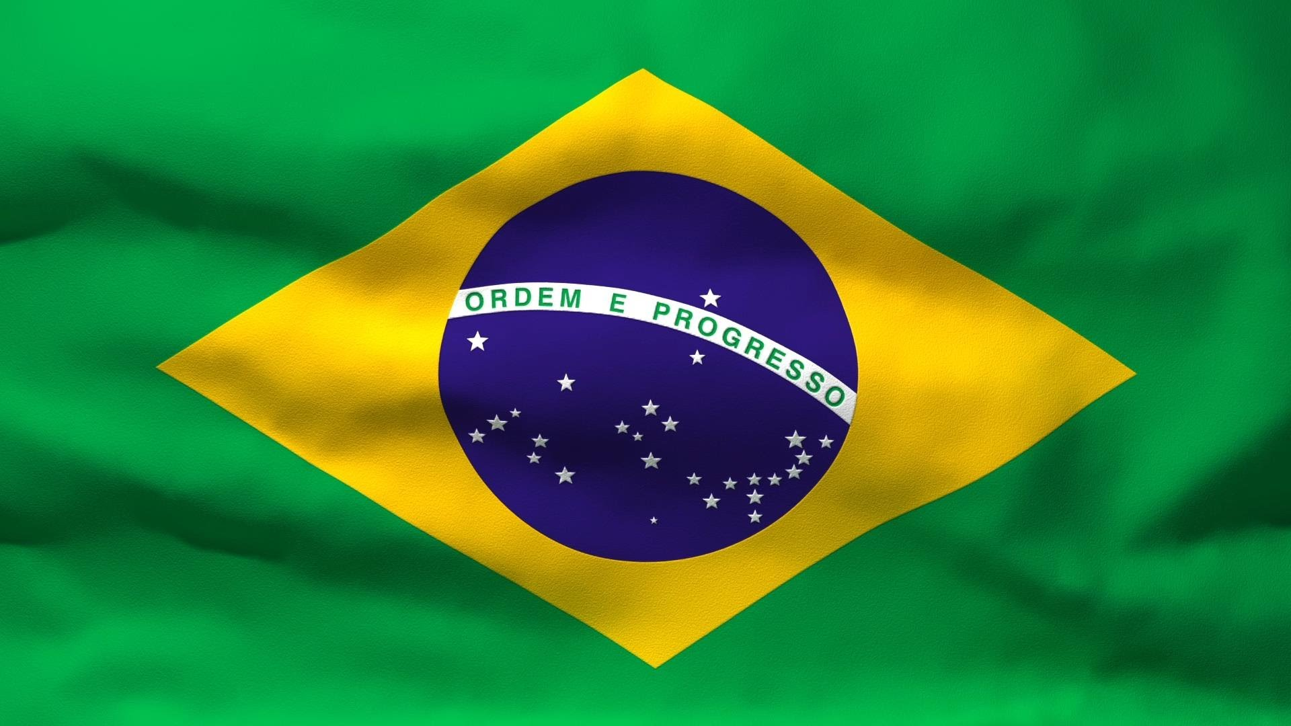
Mama Paquita
Brazilian Carnival Song

Slide 11
Verse 1
Mama Paquita, Mama Paquita, Mama Paquita has no money for papayas;
Can’t buy papayas, can’t buy bananas; She cannot buy papayas or bananas.
No ma-ma-ma-ma,
Mama Paquita, Mama Paquita, Mama Paquita, will not have a ripe papaya;
No ripe papaya, no ripe banana,
So go to Carnival to laugh and dance and sing.
Verse 2
Mama Paquita, Mama Paquita, Mama Paquita has no money for pajamas;
Can’t buy pajamas, can’t buy sombreros; She cannot buy pajamas or sombreros.
No ma-ma-ma-ma,
Mama Paquita, Mama Paquita, Mama Paquita, will not have the fine pajamas;
No fine pajamas, no fine sombreros,
So go to Carnival to laugh and dance and sing.

Slide 12
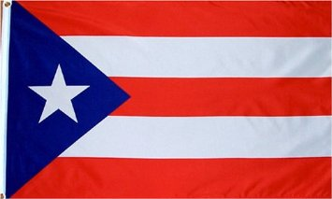
La Paloma Se Fue
The Dove That Flew Away
Puerto Rican Folk Song
vocal
pronunciation

Slide 13
Spanish
¿Señores no han visto la Paloma que voló del palomar?
¿Señores no han visto la Paloma que voló del palomar?
Se fue la Paloma, se fue la Paloma, se fue para no volver.
Se fue la Paloma, se fue la Paloma, se fue para no volver.
English
Has anyone seen him? The dove that flew away and left his home.
Has anyone seen him? The dove that flew away and left his home.
He’s gone, la paloma, he’s gone, la paloma, he’s gone, never to return.
He’s gone, la paloma, he’s gone, la paloma, he’s gone, never to return.

Slide 14
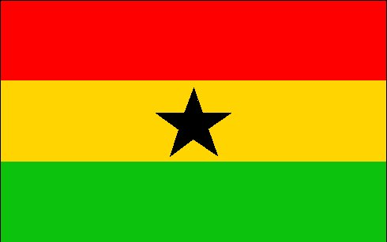
Kye Kye Kule
African Call-and-Response Song
&
Obo Asi Me Nsa
Akan Stone-Passing Game
KYE vocal pronunciation
OBO vocal pronunciation

Slide 15
Kye Kye Kule
Kye kye kule Kye kye kule
Kye kye kofi nsa Kye kye kofi nsa
Kofi nsa langa Kofi nsa langa
Kaka shi langa Kaka shi langa
Kum adnede Kum adende
Kum adende, Hey!
Obo Asi Me Nsa
Obo asi me nsa nana, Obo asi me nsa,
Obo asi me nsa nana, Obo asi me nsa.

Slide 16

Mongolian Night Song
Traditional Inner Mongolian Song

Slide 17
Verse 1
Little girl who tends the sheep, Bring them to the fold to sleep.
Little lambs are bouncing by to their mother’s bleating cry,
Underneath a starlit sky
(4 measures of rest)
All alone she waits.
“In the dark I’m not afraid. I’ve a lamp to light the way.”
Verse 2
In the moonlight’s golden glow, Soft the wind begins to blow.
Little lambs are fast asleep, lying by the other sheep.
Still a silent watch she keeps.
(4 measures of rest)
All alone she waits.
“When I’m tending all alone, All I think about is home.”

Slide 18

I Let Her Go, Go
Folk Song from Trinidad and Tobago

Slide 19
I let her go, go
Ee ay I let her go, go,
Ee ay I let her go
I let her go, go, go.

Slide 20

Frére Jacques
French
vocal
pronunciation

Slide 21
Frére Jacques, Frére Jacques,
Dormezvous, dormezvous?
Sonnez les matines, sonnez les matines,
Din, dan, don, din, dan, don.
Are you sleeping, are you sleeping,
Brother John, Brother John,
Morning bells are ringing, morning bells are
ringing,
Ding, dang, dong, ding, dang, dong.

Slide 22


Hey Ya Na
Traditional Apache Song

Slide 23
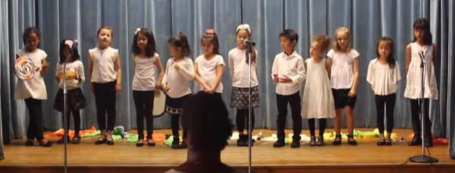
Hey ya na, hey ya na. O ha le ya na ya.
Hey ya na, hey ya na. O ha le ya na ya.
Hey ya, Hey ya, Hey ya na. O ha le ya na ya.
Hey ya, Hey ya, Hey ya na. O ha le ya na ya.

Slide 24
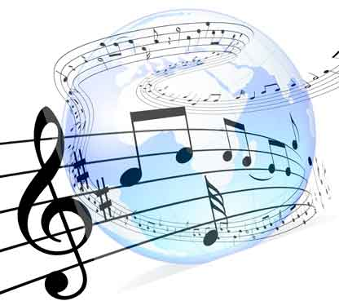
A World of Music Teresa Jennings
vocal
instrumental

Slide 25
One world. One voice. One world of song.
One world. One voice. We all belong!
One world. (One world.) A world of music.
Picture this: one world sharing a melody.
Picture this: one world sharing a song.
If we could picture a world where we stand side by side,
and imagine how nice it would be,
then we could hear in our minds what a sound we could make
with our voices in true harmony.
One world. One voice. One world of song.
One world. One voice. We all belong!
Music is part of ev’ryone.
One world. (One world.) A world of music.

Slide 26
Picture this: one world singing in harmony.
Picture this: one world singing a song.
If we could picture a world where we stand side by side,
and imagine how nice it would be,
then we could hear in our minds what a sound we could make
with our voices in true harmony.
One world. One voice. One world of song.
One world. One voice. We all belong!
Music is part of ev’ryone.
One world. (One world.) A world of music. Music!
A world of music. Music!
A world of music. Music!
A world of music. Music!
One world. (One world.) A world of music. One world!

Slide 27
