Slide 1
Welcome To The 1st Grade Production
A Musical On The
Solar System

Slide 2
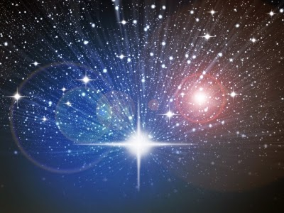
Star Shining In The Sky

Slide 4
Scene 1 Ms. Llamas
Did you know that the Earth is the 5th largest planet and the third planet from the sun?
Did you know that 70% of the Earth is water?
Did you know that the center of the Earth is hotter than the Sun?
Today we celebrate this beautiful planet. The planet we call Earth, the planet we call home.

Slide 5
Scene 1 continued Ms. Llamas
Like the song says, “It’s a big beautiful planet in the sky. It’s my home, it’s where I live.”
“You and many others live here too. The Earth is our home. It’s where we live.”
The Earth rotates around the sun at about 1,000 miles per hour!
Of all the planets in our solar system, the Earth is the only planet known to have life.

Slide 6
Our Next Song Is About The Moon

Slide 7
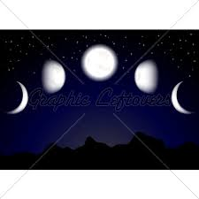
PHASES OF THE MOON

Slide 8
Scene 2 Ms. Vincent
The order of the planets from the sun are:
Mercury, Venus, Earth and Mars
Jupiter, Saturn, Uranus, Neptune and Pluto.
Earth is known as the “Blue Planet” because of its blue seas.

Slide 9
Scene 2 continued Ms. Vincent
Mars is known as the “Red Planet” because of its dry land.
The dry land has a red color when seen from outer space.
Jupiter has the best view because it is the largest planet.
Saturn is the planet with the ring.

Slide 12
Scene 3 Ms. Camacho
Here on Earth, we get our light from the sun.
Do you know how long it takes for light to get from the sun to the Earth?
I think it takes 8 and one half minutes.
Yes, it takes 8 and one half minutes for light to get from the sun to the Earth.
Many times people call the Earth “The Blue Planet” because from space, the oceans and our atmosphere make our planet look blue.

Slide 13
EVERGREEN EVERBLUE

Slide 15
Scene 4 Ms. Martinez
Welcome to our home, the planet Earth, where everything lives and everything grows.
“It’s a big beautiful planet in the sky. It’s my home; it’s where I live.”
“You and many others live here too. The Earth is our home. It’s where we live.”
The Earth rotates around the sun at about 1,000 miles per hour!
Of all the planets on our solar system, the Earth is the only planet known to have life!
Everyone: We love our planet Earth. Help us take care of it!

Slide 17
We Hope You Enjoyed Our Show
Thank You For Coming

