Slide 1
Symbols and Metaphors
Day 1

Slide 2
Symbol:
A picture or thing that represents something else
Draw as many symbols as you can think of in 30 seconds.

Slide 3

Work as a team
To define what each symbol means. How many can you define in 30 seconds?
1
2
3
4
5
6
7
8
9
10
11
12
13
14
15
16
17
18

Slide 4
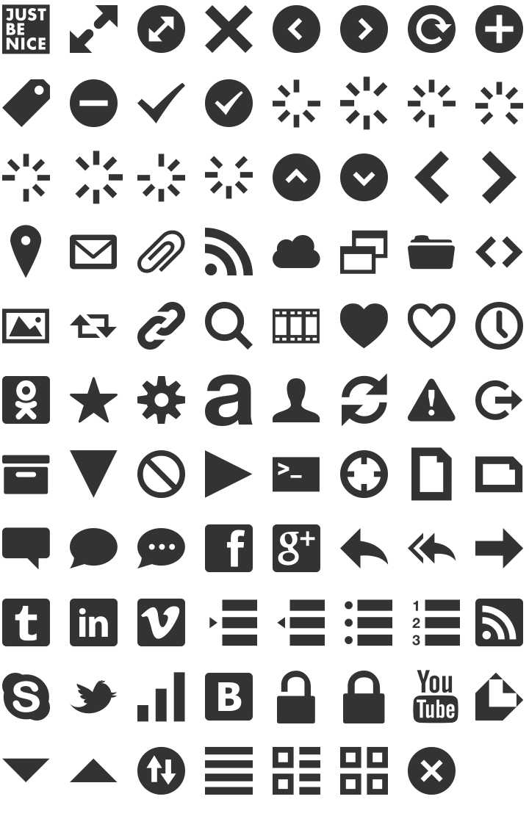


Slide 5
Does everyone assume a particular symbol means the same thing?

Slide 6
How are the various proposed meanings similar and different?

Slide 7
What are some possible reasons for the differences?

Slide 8
Can symbols simultaneously represent more than one idea?

Slide 9
How do we know which meaning is most important?

Slide 10
Metaphor:
A word or phrase used to compare two unlike objects, ideas, thoughts or feelings to provide a clearer description.
For example:
The new smartphone is as light as a feather.
I felt as free as a bird after turning in my last big assignment.

Slide 11
Day 2
How do artists use symbols and metaphors in their artwork to imply (or subtly communicate) a message?

Slide 12
Symbol:
A picture or thing that represents something else

Slide 13
Metaphor :
A word or phrase used to compare two unlike objects, ideas, thoughts or feelings to provide a clearer description.
For example:
The answer to the mystery was as clear as _______.
After skipping lunch, I was as hungry as a ___________ by dinner time.

Slide 14
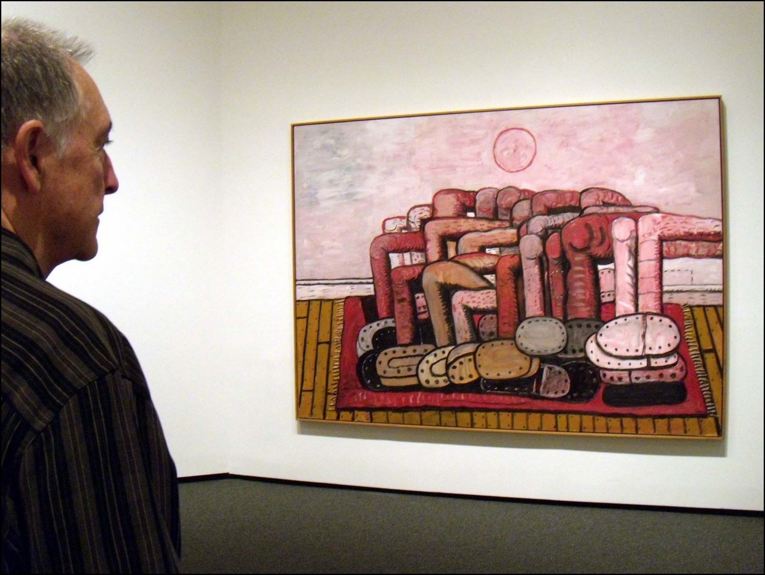
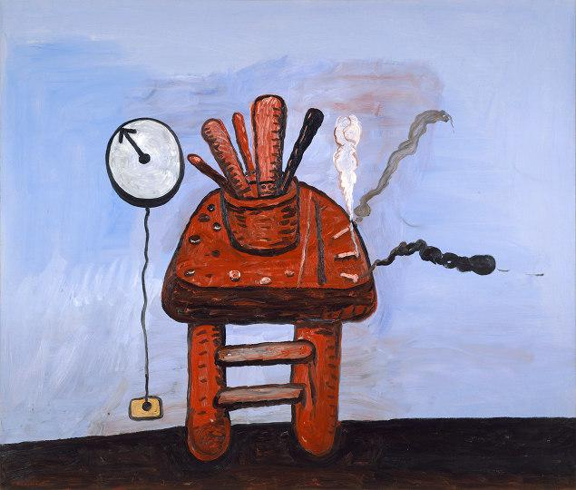
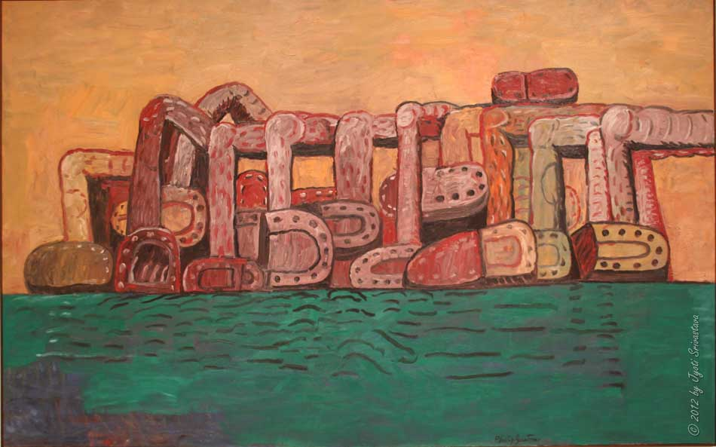
Artists often use symbols in their work to represent an implied message. What two reoccurring symbols do you see in Philip Guston’s artwork?

Slide 15
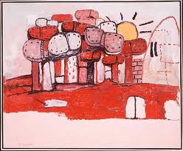
Philip Guston’s personal symbol language
Clock:
Do I have time? The clock is always ticking.
Legs: Humanity

Slide 16
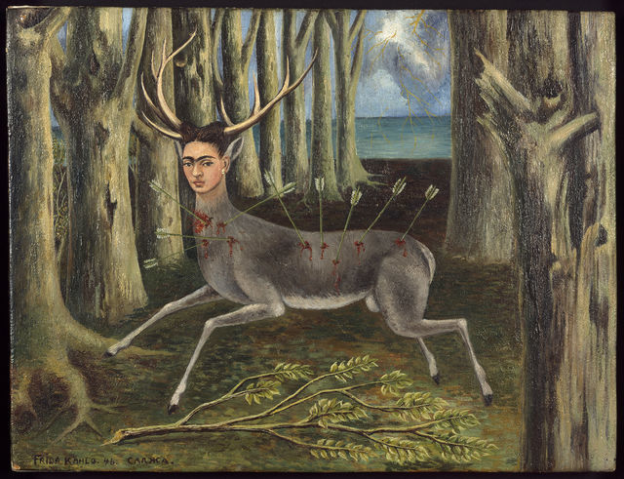
This is a self-portrait by Frida Kahlo.
What do you think these symbols represent?
What is she implying about herself?
What evidence makes you think this way?
Frida Kahlo, La venadita, 1946

Slide 17
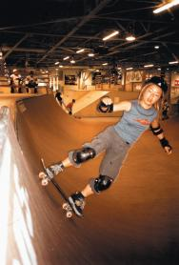
The following four artworks are part of a series. Nikki Lee, the artist, is implying a message about herself.
Rather than literally stating what this message is, she is using pictures to communicate the message in a metaphorical way.
What is the message being communicated?
Why do you think that way?
Nikki Lee, The Skateboarder Project, 2000

Slide 18
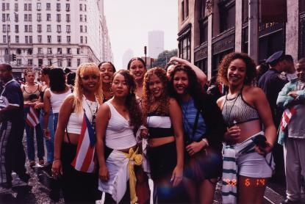
Nikki Lee, The Hispanic Project, 1998

Slide 19
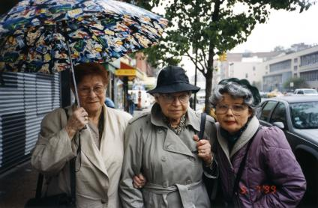
Nikki Lee, The Seniors Project, 1999

Slide 20
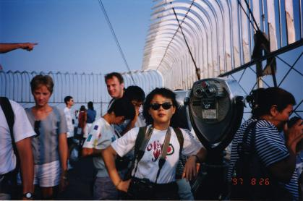
Nikki Lee, The Tourist Project, 1997

