Slide 1




Warm up: What type of music do you associate with each of these images? What about the image makes you think this way?

Slide 2
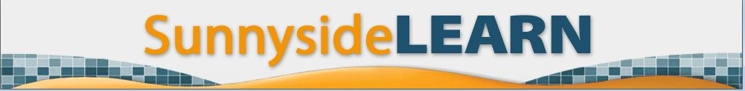
Unit One: Redesigning the Sunnyside
LEARN logo
and developing visual literacy
PART ONE OBJECTIVES: DEVELOPING VISUAL LITERACY
I will:
discuss how graphic design reflects the interests and values of certain groups of people during a particular time
identify the mood created by examples of graphic design and provide reasons why I think this way
identify examples of graphic design that appeal to my personal taste and provide reasons for my opinion
evaluate examples of graphic design based on chosen criteria

Slide 3
Think to yourself quietly:
What does the term “Graphic Design” mean?

Slide 4
Graphic Design:
the art of communication, stylizing, and problem-solving through the use of type, space and image.

Slide 5
6th VA: Re7.1.6a: Identify and interpret works of art or design that reveal how people live around the world and what they value. (I will describe how past and present graphic design reflect the interests and values of certain groups of people)
As we view the following examples of graphic design, think about the following questions:
What message is the artist trying to convey?
Who is the intended audience?

Slide 6
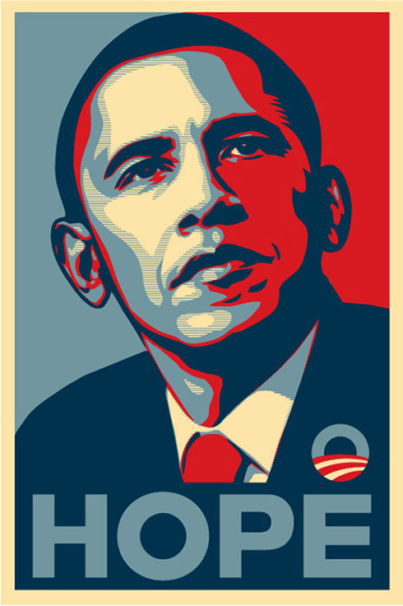
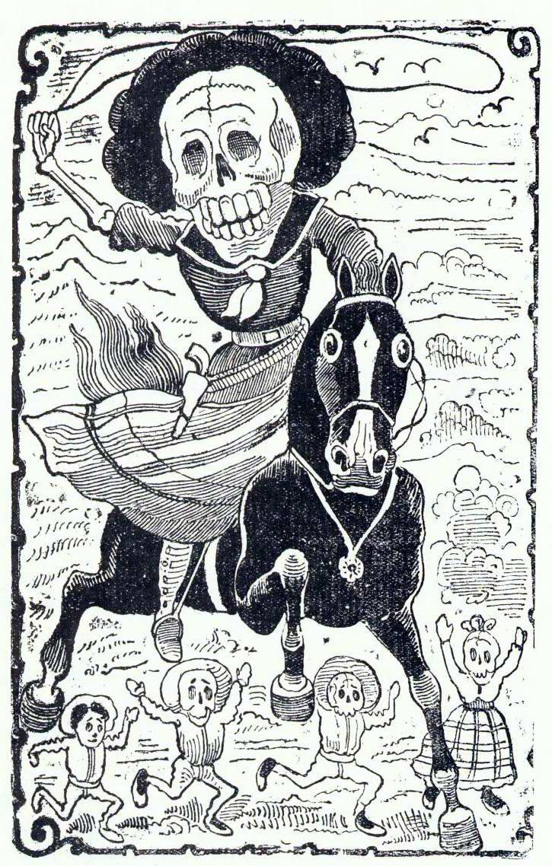
“Calavera Revolucionaria”
(1910) José Guadalupe Posada worked during a time of great political and social revolution in Mexico. He was an outspoken critic of the government, a political satirist, and an artist for the common people.
“Hope” (2008)
Artist: Shepard Fairey

Slide 7


Produced by the British government in 1939, this motivational poster intended to raise civilian morale despite the devastating German air raids on London. (it was never actually distributed, however, until being rediscovered in 2000).
“We can do it!” (1942) J. Howard Miller was hired by the Westinghouse Company's War Production Coordinating Committee to create a series of posters for the war effort.

Slide 8
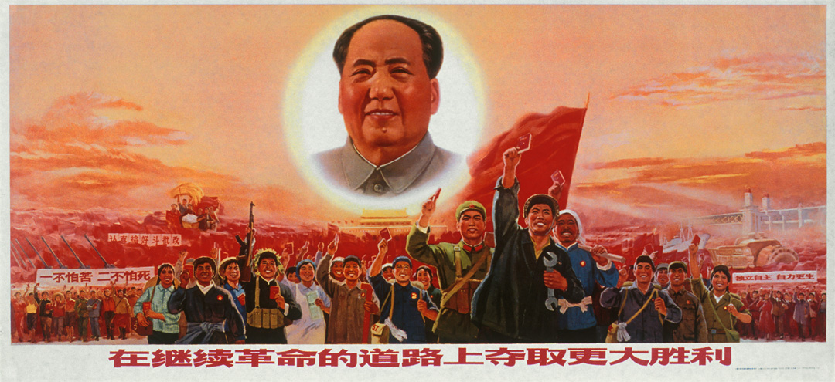
“In Following the Revolutionary Road, Strive for an Even Greater Victory”
This poster was created during China’s Cultural Revolution, a political and social movement that occurred between 1966-76. Chairman of Communist Party of China, Mao Zedong aimed to remove capitalist, traditional, and cultural elements from Chinese society while promoting communism.

Slide 9
What message is the artist trying to convey?
Who is the intended audience?
“Hope” (2008)
Artist: Shepard Fairey

Slide 10
What message is the artist trying to convey?
Who is the intended audience?
“Calavera Revolucionaria”
(1910) José Guadalupe Posada worked during a time of great political and social revolution in Mexico. He was an outspoken critic of the government, a political satirist, and an artist for the common people.

Slide 11
What message is the artist trying to convey?
Who is the intended audience?
“We can do it!” (1942) J. Howard Miller was hired by the Westinghouse Company's War Production Coordinating Committee to create a series of posters for the war effort.

Slide 12
What message is the artist trying to convey?
Who is the intended audience?
Produced by the British government in 1939, this motivational poster intended to raise civilian morale despite the devastating German air raids on London. (it was never actually distributed, however, until being rediscovered in 2000).

Slide 13
“In Following the Revolutionary Road, Strive for an Even Greater Victory”
This poster was created during China’s Cultural Revolution, a political and social movement that occurred between 1966-76. Chairman of Communist Party of China, Mao Zedong aimed to remove capitalist, traditional, and cultural elements from Chinese society while promoting communism.
What message is the artist trying to convey?
Who is the intended audience?

Slide 14
6th VA: Re7.2.6a: Analyze ways that visual components and cultural associations suggested by images influence ideas, emotions, and actions. (I will identify the mood or tone created by examples of graphic design.)
6th VA: Re8.1.6a: Interpret art by distinguishing between relevant and non-relevant contextual information and analyzing subject matter, characteristics of form and structure, and use of media to identify ideas and mood conveyed. (I will provide specific reasons why I think these examples create a specific mood or tone.)
The “mood” refers to the way the image makes a person feel.
(For example: Serious, Sad, Playful, Curious, Scared, Angry, Proud, Confident, Inspired, Informed, Motivated, Competitive, etc.)
How would you describe the mood of each image and what about the image makes you feel this way?
Consider the subject matter
(what or who is displayed, what appears to be going on)
…and the way the artist depicts the subject matter
(distortion, colors used, style of text).

Slide 15
Examples of moods: Serious, Sad, Playful, Curious, Scared, Angry, Proud, Confident, Inspired, Informed, Motivated, Competitive, etc.)
What about the image makes you feel this way? Consider the subject matter (what or who is displayed, what appears to be going on)…and the way the artist depicts the subject matter (distortion, colors used, style of text).
1
2
3
4
5

Slide 16

6th VA: Cn11.1.6a: Analyze how art reflects changing times, traditions, resources, and cultural uses.
(I will identify how google doodles reflect contemporary cultures all over the world)
We’ve just discussed how graphic artists create images that intend to communicate messages to a group of people. Each image gives us a glimpse of what life was like in a specific place and time in history.
Today, people all over the world use the internet to display their visual messages. For example, the popular search engine “Google” provides opportunities for people to use their artistic abilities and imagination to communicate messages to a wide audience. Unlike the examples we just viewed, the following Google “Doodles” address less politically charged topics.

Slide 17



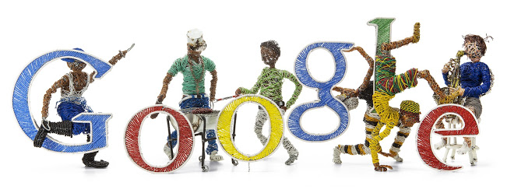
What are these Google artists communicating about the cultures represented in their Doodles?
February 3, 2014
Anniversary of the coldest temperature ever recorded in Canada
August 1, 2014 Swiss National Day 2014
June 28, 2014 World Cup 2014 #38
April 27, 2014 South Africa Freedom Day
“Doodles are the fun, surprising, and sometimes spontaneous changes that are made to the Google logo to celebrate holidays, anniversaries, and the lives of famous artists, pioneers, and scientists.” http://www.google.com/doodles/about

Slide 18
6th VA: Cr1.2.6a: Formulate an artistic investigation of personally relevant content for creating art. (I will identify examples of google doodles that appeal to my personal taste and provide reasons for my opinion)
Google 4 Doodle 2014
This year's theme:
If I Could Invent One Thing to Make the World a Better Place...
How would you evaluate these 6th and 7th grade student submissions?
Which one do you like best and why?

Slide 19
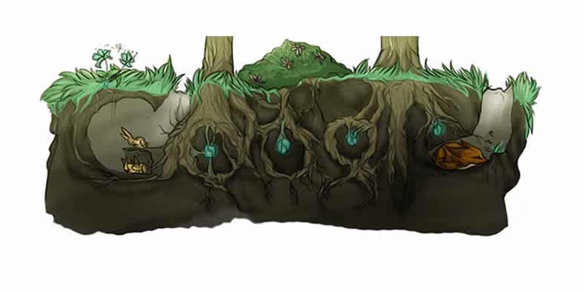
"If I could invent one thing to make the world a better place I would invent a tiny capsule-like seed that plants can use to grow faster and have the power to share roots; so they all benefit and can protect animals better."

Slide 20
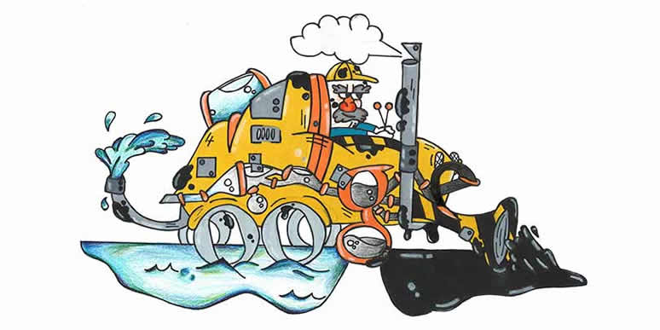
"My invention to change the world is a Gas and Oil Organic Purifier, or G.O.O.P. It drives over oil spills and sucks up oil, then the oil is filtered out into fresh water."

Slide 21
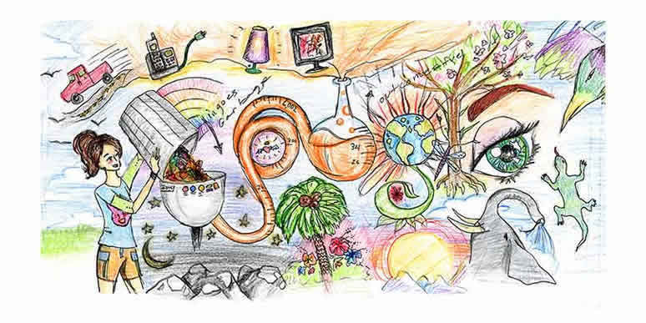
"If I could invent one thing to make the world a better place, I would invent a machine that turned garbage into fuel. This way we could use less natural resources and have no oil spills."

Slide 22
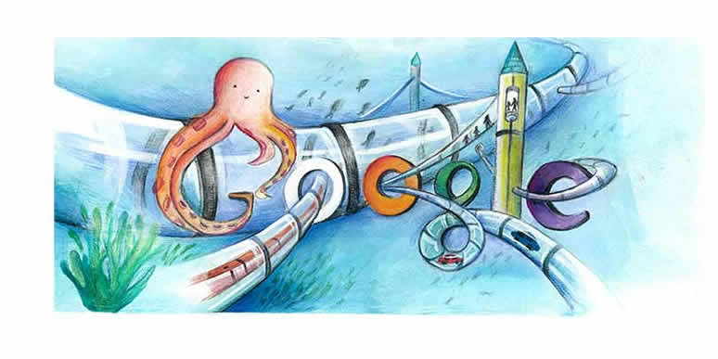
"This doodle is about inventions that allow us to live and move underwater. It includes tunnels for transportation and sea creatures."

Slide 23
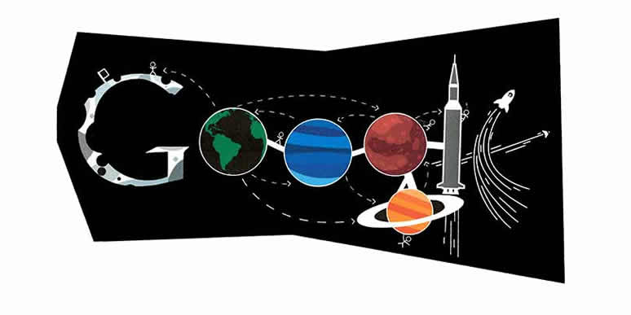
"The doodle displays the invention of a Universal Nexus: a connection between humans to humans and worlds to worlds. The nexus- which, by definition, links places and ideas- would allow us to explore the universe to its absolute potential and create junctions between our past, present, and future."

Slide 24

"To make the world a better place doesn’t mean we need more technology, it needs more friendships. True friends are basically a part of your family; they care, they forgive, they make you happy, and love you with all their heart."

Slide 25
1
4
2
5
3
6

Slide 26
6th VA: Re9.1.6a: Develop and apply relevant criteria to evaluate a work of art.
(I will identify criteria and use these criteria to evaluate examples of google doodles.)
Next, let’s choose criteria to base our evaluations upon. For example, the most unusual or inventive idea, the most visually stimulating, or the best craftsmanship.

Slide 27
1
4
2
5
3
6

Slide 28
Unit One: Redesigning the Sunnyside
LEARN logo
and developing visual literacy
PART TWO OBJECTIVES: REDESIGNING THE SUNNYSIDE LEARN LOGO
I will:
collectively brainstorm design ideas with the class
independently brainstorm ideas for my design that are interesting/meaningful to me
challenge myself by creating a unique Sunnyside LEARN logo that is engaging to a wide range of viewers

Slide 29
6th VA: Cr1.1.6a: Combine concepts collaboratively to generate innovative ideas for creating art. (I will collectively brainstorm design ideas with the class)
What words do you associate with:
“Learn”?

Slide 30
What words do you associate with: “Education”?

Slide 31
6th VA: Cn10.1.6a: Generate a collection of ideas reflecting current interests and concerns that could be investigated in art-making. (I will independently brainstorm ideas for my design that are interesting/meaningful to me)
On your own, brainstorm as many words as you can think of that relate “Learn” and “Education.”

Slide 32
Next, choose one of these ideas and continue brainstorming.
What does it look like? What images do you associate with it?

Slide 33
6th VA: Cr2.1.6a: Demonstrate openness in trying new ideas, materials, methods, and approaches in making works of art and design. (I will challenge myself by creating a unique Sunnyside LEARN logo)
6th VA: Cr2.3.6a: Design or redesign objects, places, or systems that meet the identified needs of diverse users. (I will redesign the LEARN logo so that it is more engaging for both students and adults to view.)
Begin sketching your ideas. Consider the message and the mood you are trying to communicate. How are you going to accomplish this?
(Consider subject matter, style, and color.)

