Slide 1
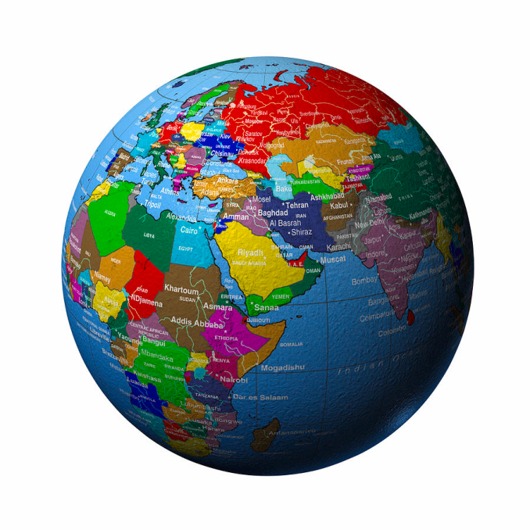
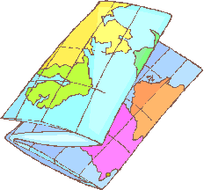
Geography vocabulary

Slide 2
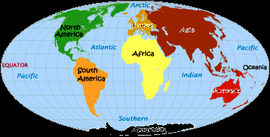
Vocabulary
What is a continent?
Very large landmasses found on Earth
There are 7: North America, South America, Europe, Africa, Asia, Antarctica, and Australia

Slide 3
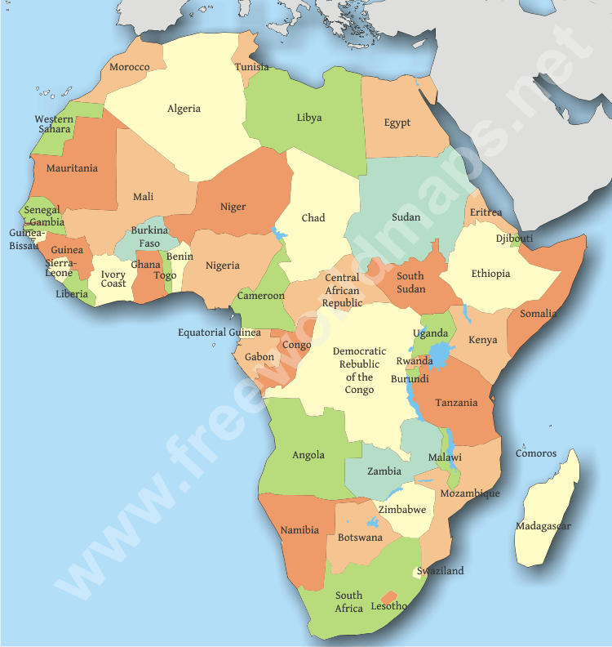
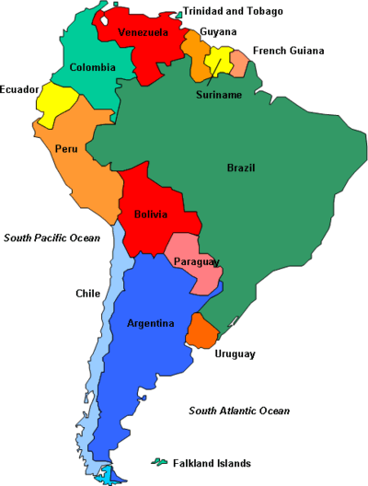
Vocabulary
What is a country?
A land lived in by people with a common government.
Examples: United States, France, Italy, Turkey, Egypt

Slide 4
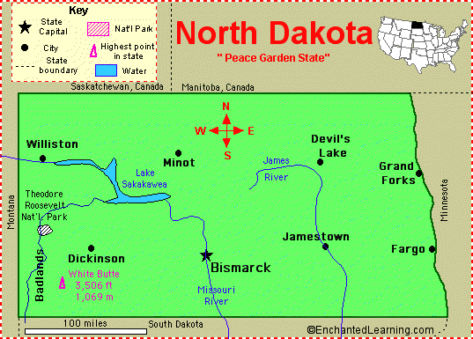
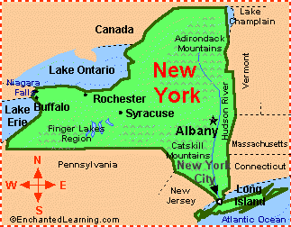
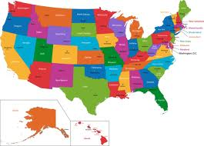
Vocabulary
What is a state?
A body of people living in a certain territory under ONE government.
Examples: Arizona, Colorado, New York, North Dakota

Slide 5
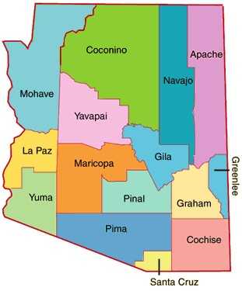
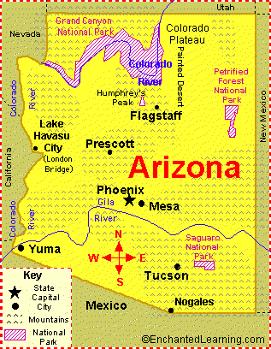
Vocabulary
What is a county?
A political and administrative division of a state providing certain local government and services.
Examples: Pima, Maricopa, Cochise, Greenlee

Slide 6
Counties in ARizona

Slide 7
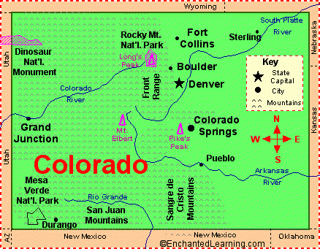
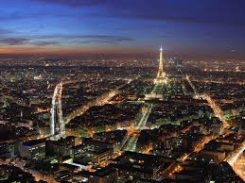
Vocabulary
What is a city?
A place in which people live that is larger or more important than a town.
Examples: Tucson, Denver, Salt Lake City, Santa Fe

Slide 8
Cities in Colorado

Slide 9
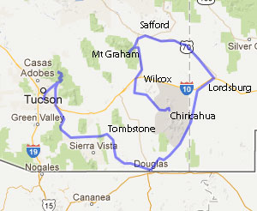
Vocabulary
What is a town?
An area that has a name, defined boundaries, and local government, larger than a village, smaller than a city.
Examples: Tombstone, Bisbee, Douglas, Jerome

Slide 10
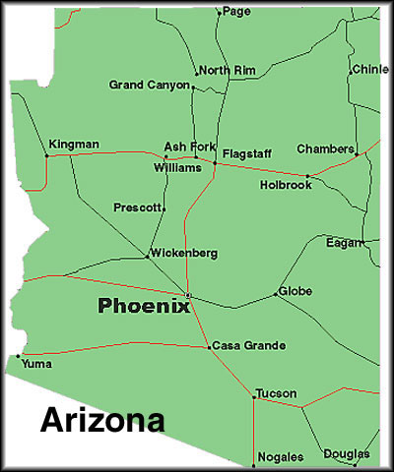
Towns in ARizona

Slide 11
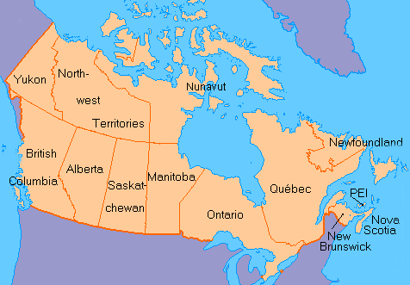
Vocabulary
What is a province?
Part of a country having a government of its own
Example: Canada has provinces: Alberta

Slide 12
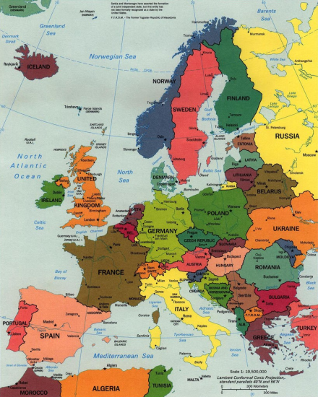
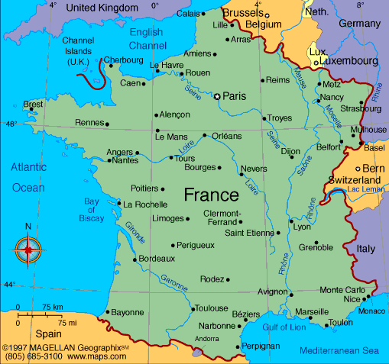
Essential Question and Summary
Essential Question:
Summary:
What is the difference between a continent, a country, and a state?
Write a 4-5 sentence summary that includes a topic sentence and a concluding sentence.

Slide 13
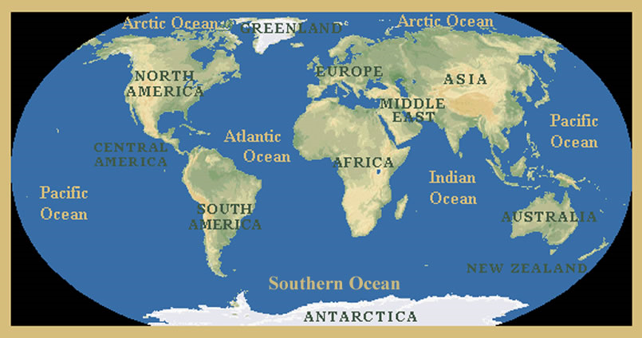
The 7 Continents Map
You will be given a World Map
Label the 7 continents
Write the name of the 5 Oceans
Color the bodies of water blue
Color each continent a different color

