Slide 1
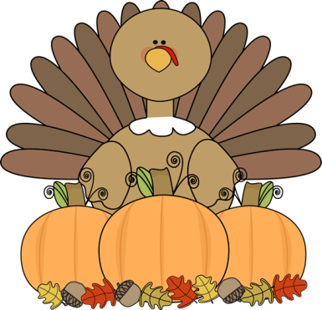
Kindergarten News
What’s happening…
We have learned the sounds our letters make, are starting to write words from sounds. We can write our numbers and letters. We will continue to identify basic and geometric shapes and practice adding to 5.
Please continue counting to 100, practice name writing, and shoe tying.
Attendance matters, please come to school every day on time. Students with perfect attendance earn otter pops and free dress each month.
4 tardies = 1 recess detention.
We are collecting box tops, each worth 10 cents. Please send them in with your child. The class with the most wins an eegees party.
Important Dates
Nov. 6th Student of the month 8am-8:30
Nov. 6th Sundae with the Principal 2-2:30pm
Nov. 7th Make a Difference Day 8am-12pm
Nov. 11th Veteran’s Day – NO SCHOOL
Nov.16th-20th Scholastic book fair
Nov. 19th Family Math Night 5:30-6:30pm
Nov. 26th-27th Thanksgiving Break – NO SCHOOL
Reminder…..
We are welcoming snack donations. All snacks should be enough to share with the entire class, store bought, and not contain peanuts.
EEGEES is sold on Wednesday’s during lunch for $1.00.
All students should come to school in proper uniform (red or white shirt and navy blue or khaki pants.)
Tuesday’s: Collegiate shirt day with uniform bottoms.
Teacher Information and Reminders
Homework is sent home at the beginning of the week and should be returned by the end of the week. Students should write their names on every sheet.
Please contact your child’s teacher if you ever have a question/concern.
Thank you,
Ms. Lord Noval@susd12.org
Mrs. Myers GlendaM@susd12.org
Ms. Paquette JenniferP@susd12.org
Friday’s: Drexel Pride day. Wear panther tops with uniform bottoms. Shirts are sold for $10.

