Slide 1
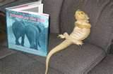
Australian Bearded Dragons
You should own Bearded Dragons
Propaganda Techniques

Slide 2
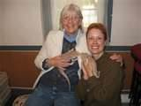
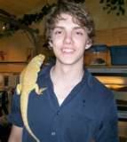
Bearded Dragons as pets…
*Everybody else owns Bearded Dragons as pets and so
should you!
*Be part of the cool crowd by owning a Bearded Dragon!
*Don’t be left out!
Notes:
Bandwagon

Slide 3
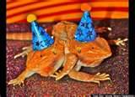
Only the elite teachers own Australian Bearded Dragons!
Ms. Mirenda’s Quotes
Mrs. Baer’s Quotes
I own one Bearded Dragon and she is an amazing pet!
I want a pet that only needs attention once-in-awhile.
I own two incredible Bearded Dragons!
I lead a busy life so my Bearded Dragons are a perfect pet for me.
Notes:
Testimonials

Slide 4
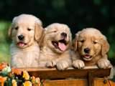
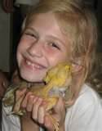
The LOVE you feel for puppies is the same LOVE you should feel toward Bearded Dragons.
Bearded Dragons are loveable!
Dogs are loveable!
Notes:
Transfer

Slide 5
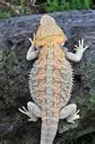
Bearded Dragons are
THE BEST PETS!
THE BEST PETS
are quiet!
don’t eat very much food.
sleep for two-three weeks at a time.
love to cuddle with people.
THE BEST PETS
THE BEST PETS
THE BEST PETS
Notes:
Repetition

Slide 6
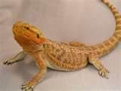
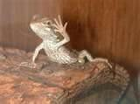
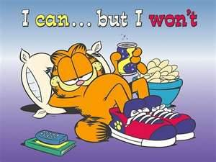
Beardies are…
cute
entertaining
lazy
Great to cuddle with!
Notes:
Loaded words (emotional)

Slide 7
In Conclusion…
The proof stacks up to prove Bearded Dragons are the
pet ever!
BEST

Slide 8
PROPAGANDA
Included in this PowerPoint are five types of propaganda.
* Can you identify all five types?
* What examples are used to prove each type of propaganda?

