Slide 1
Commonwealth Club Address
Cesar Chavez Unit Vocabulary

Slide 2
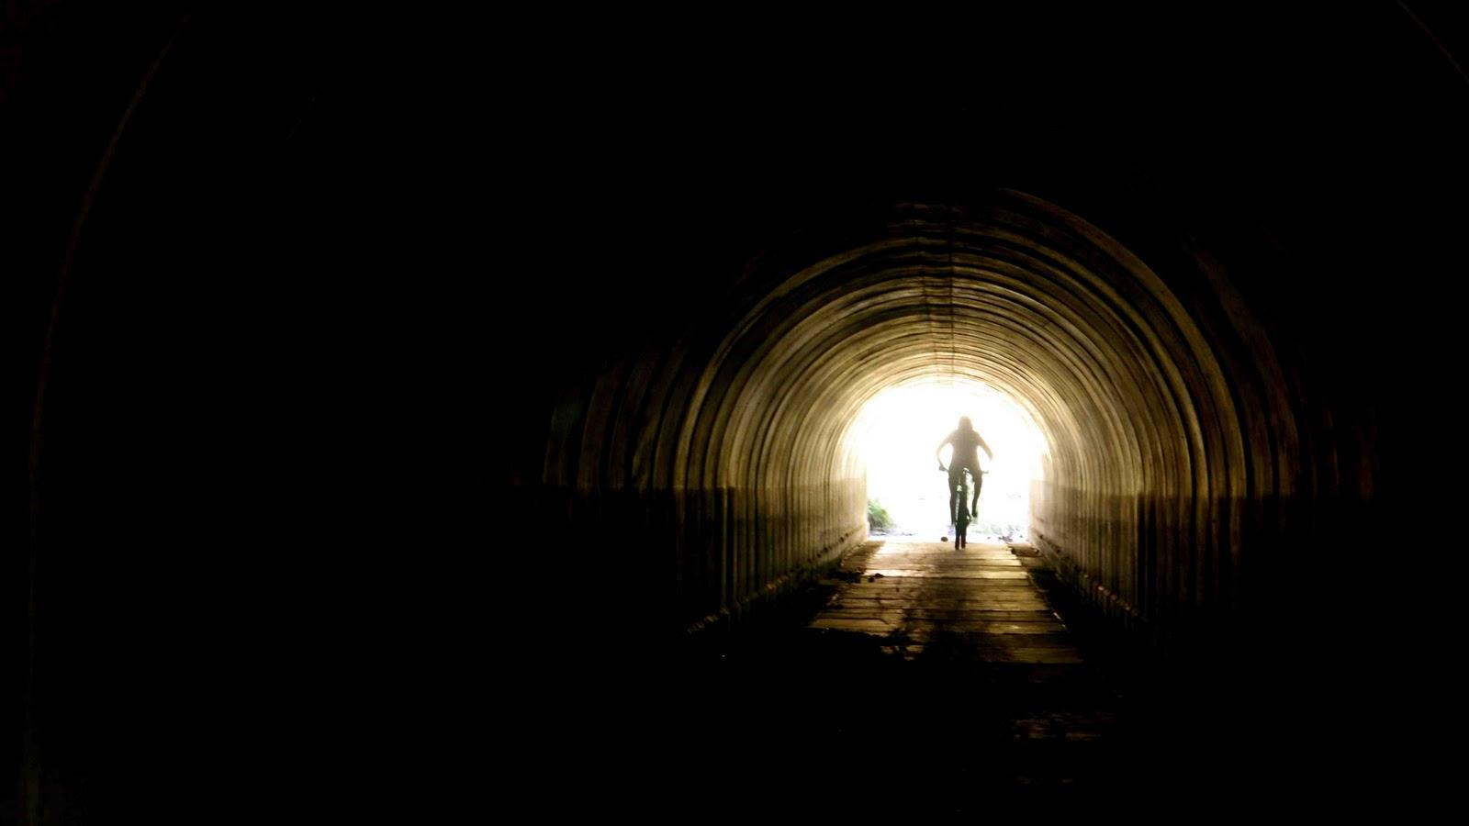
Tunnel Vision Page 1
Definition:
Defective sight in which objects not in the center field of vision cannot be properly seen

Slide 3
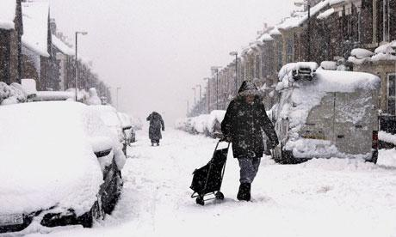
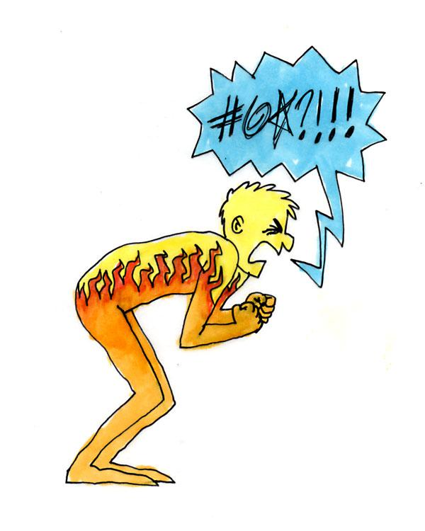
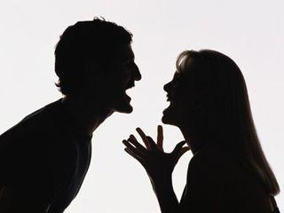
Savage Page 1
Definition:
Harsh

Slide 4
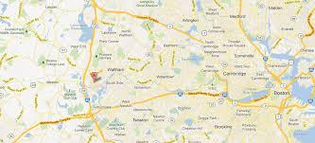
Migrant Page 2
Definition:
Moving from place to place in search of work

Slide 5
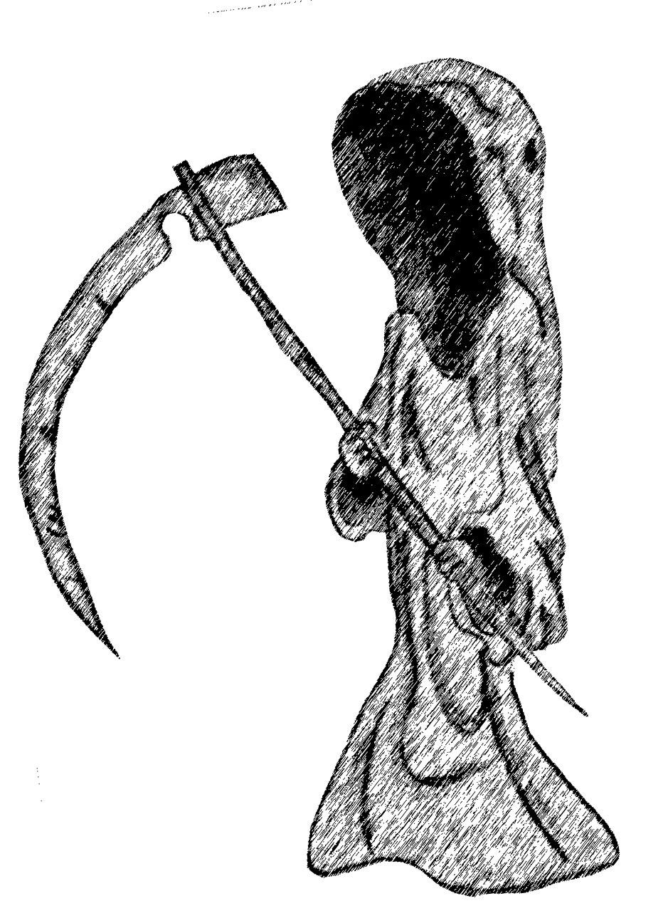
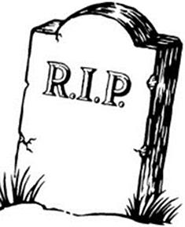
Mortality Page 2
Definition:
Death

Slide 6
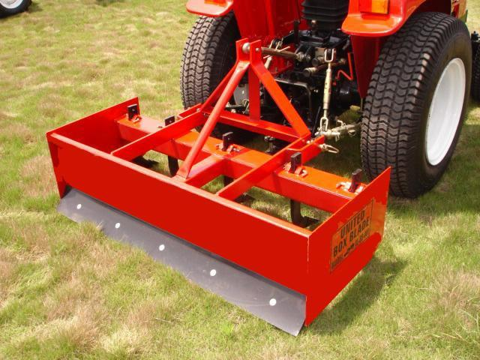
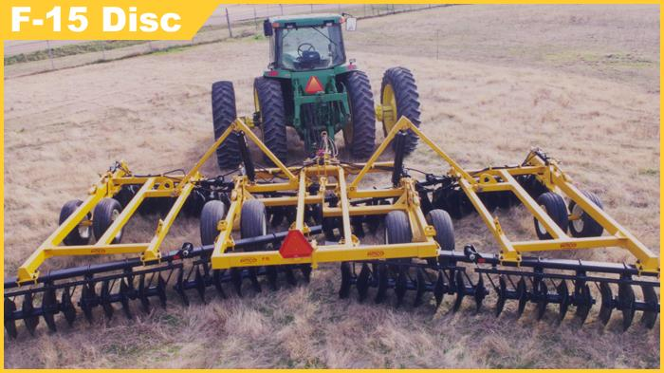
Implements Page 2
Definition:
Tools

Slide 7
Chattel Page 2
Definition:
Property or personal possession

Slide 8
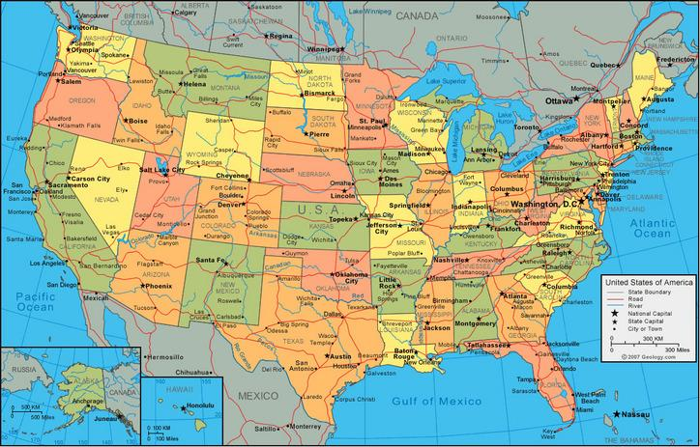
Anglo Page 3
Definition:
A white American not of Hispanic descent

Slide 9
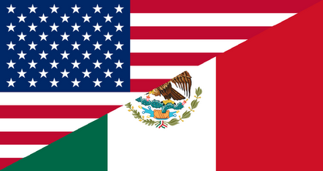
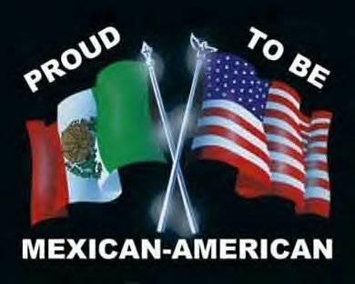
Chicano Page 3
Definition:
An American of Mexican descent

Slide 10
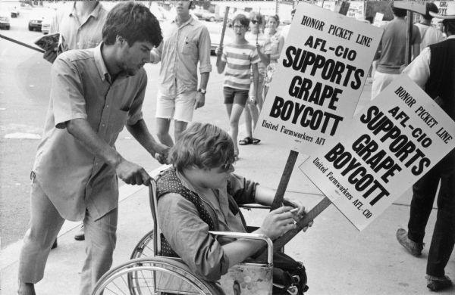
Union Page 3
Definition:
An organization of workers formed to advance the interests of its members

Slide 11
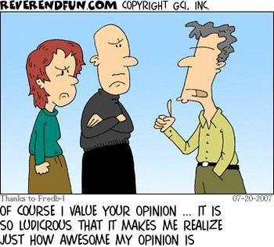
Assert Page 3
Definition:
claim

Slide 12
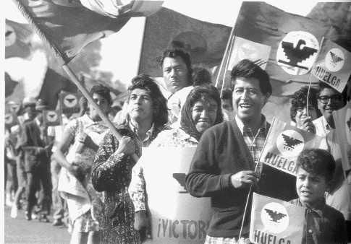
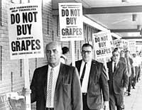
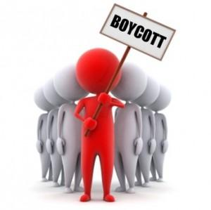
Boycott Page 6
Definition:
Refusal by a group to buy goods or services to show support for a cause

Slide 13
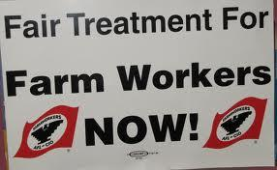
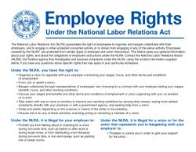
Agricultural Labor Relations Act Page 6
Definition:
Law enacted by the state of California in 1975 to protect the right of the farm workers to self-organize and negotiate the conditions of their employment

Slide 14
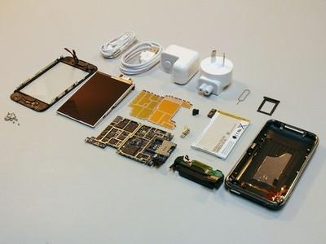
Dismantle Page 6
Definition:
Take apart

Slide 15
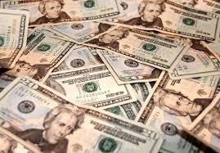
Disposable Page 9
Definition:
Available

Slide 16
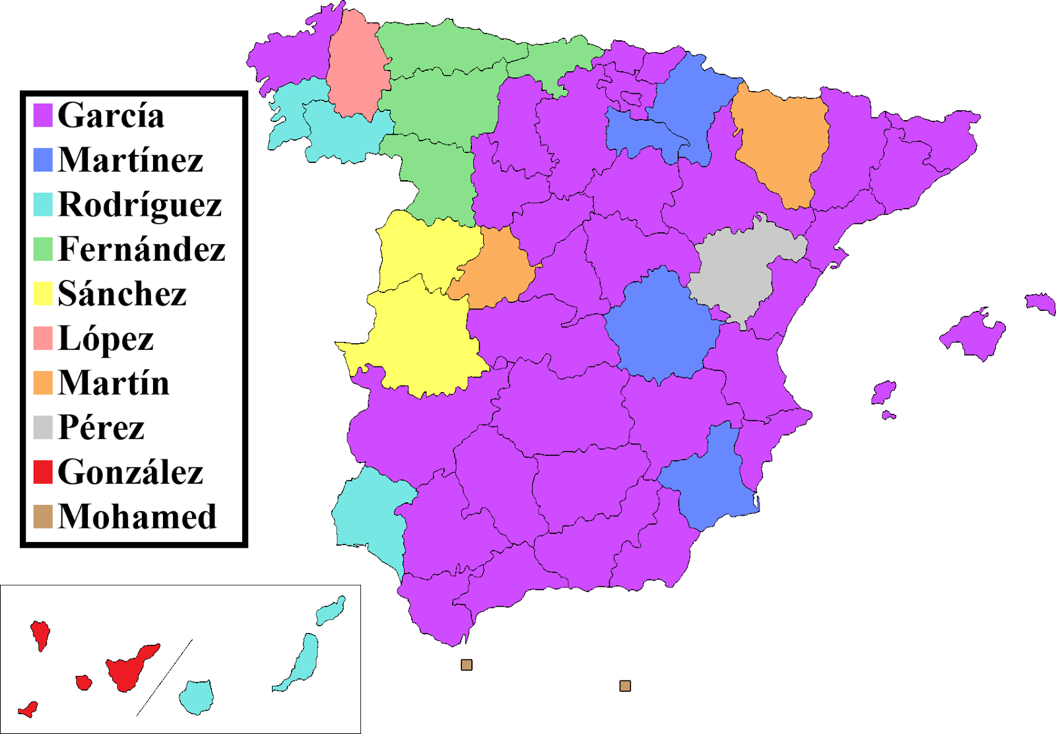
Surname Page 9
Definition:
The family or last name

Slide 17
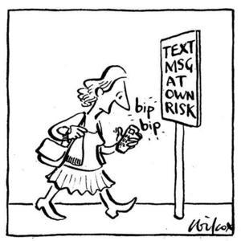
Wanton Page 10
Definition:
Careless, undisciplined

Slide 18
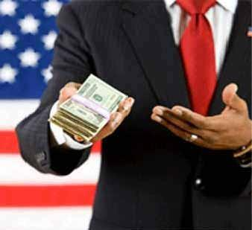
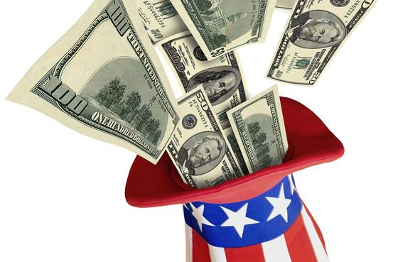
Subsidies Page 10
Definition:
Money granted by the governmemt

Slide 19
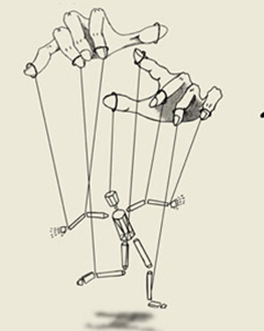
Subjugate Page 10
Definition:
To control; to make submissive

