Slide 5
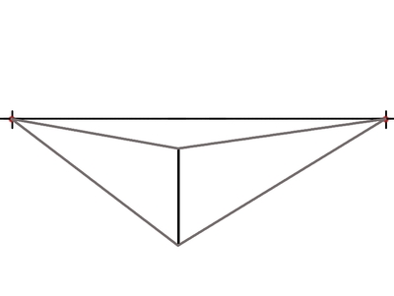
1.) Draw the eye level line. 2.) Draw the closet corner of your box- vertically.
3.) Connect corner top to vanishing point. 4.) Repeat with bottom corner.

Slide 6
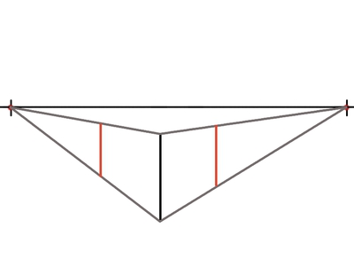
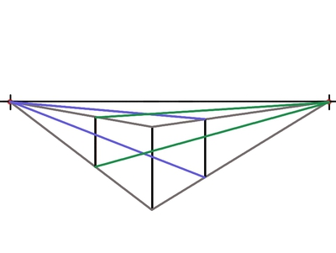
5.) Determine depth of box. Mark with vertical lines.
3.) Connect right and left corners to vanishing point.

Slide 7
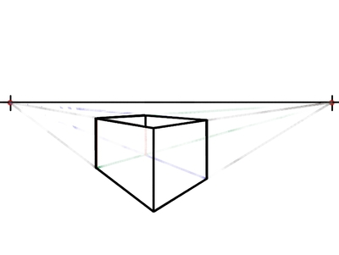
7.) Erase guide lines .
8.) Add details.

Slide 10
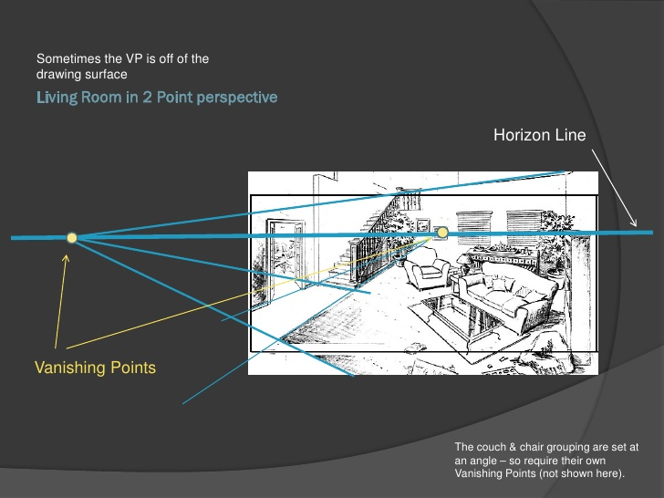

Slide 12
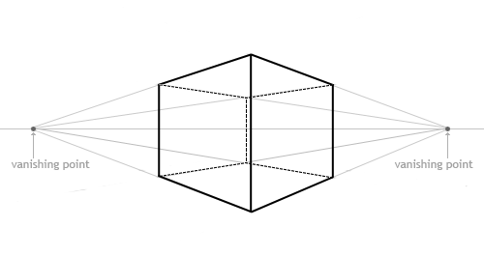

Slide 13
