Slide 1
Vocabulary
October 20- 24

Slide 2
Slough
Definition: an area of soft, muddy ground; swamp or swamplike region.
Part of speech: noun

Slide 3
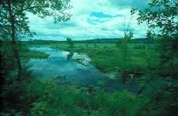
Slough
Laura and Carrie walked through the slough to try to get home faster.

Slide 4
blizzard
Definition: a very heavy snowstorm with high winds.
Part of speech: noun

Slide 5
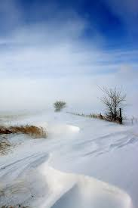
blizzard
The blizzard on the prairie came
quickly.

Slide 6
shanty
Definition: a small crudely built dwelling or shelter usually of wood.
Part of speech: noun

Slide 7
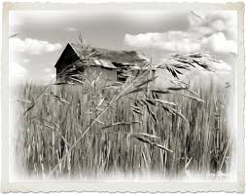
shanty
The girls ran to the shanty to help
their ma with supper.

Slide 8
trembling
Definition: to shake involuntarily (as with fear or cold).
Part of speech: verb

Slide 9
trembling
He was trembling because
he was so cold!

Slide 10
harvest
Definition: The act or process of gathering a crop.
Part of speech: noun

Slide 11
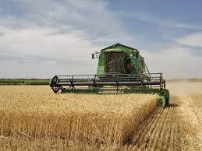
harvest
Pa had to harvest the crops before
the weather became too cold.

